Slide 1


Security Pitfalls for Workload Identities in Azure
February 15th 2024
Emanuel Palm | Cloud Consultant & Microsoft MVP
azureday.pl

Slide 2




Passwords & Passwordless
Trusted Location & Conditional Access
Trusted Devices & Authenticators
Sign-in Logs & Risk Policies
Notes:
When talking about authentication, we always talk about these things. But not…

Slide 3
We’re
not
talking about
users

Slide 4
We’re
talking about
Unmanaged Identities

Slide 5

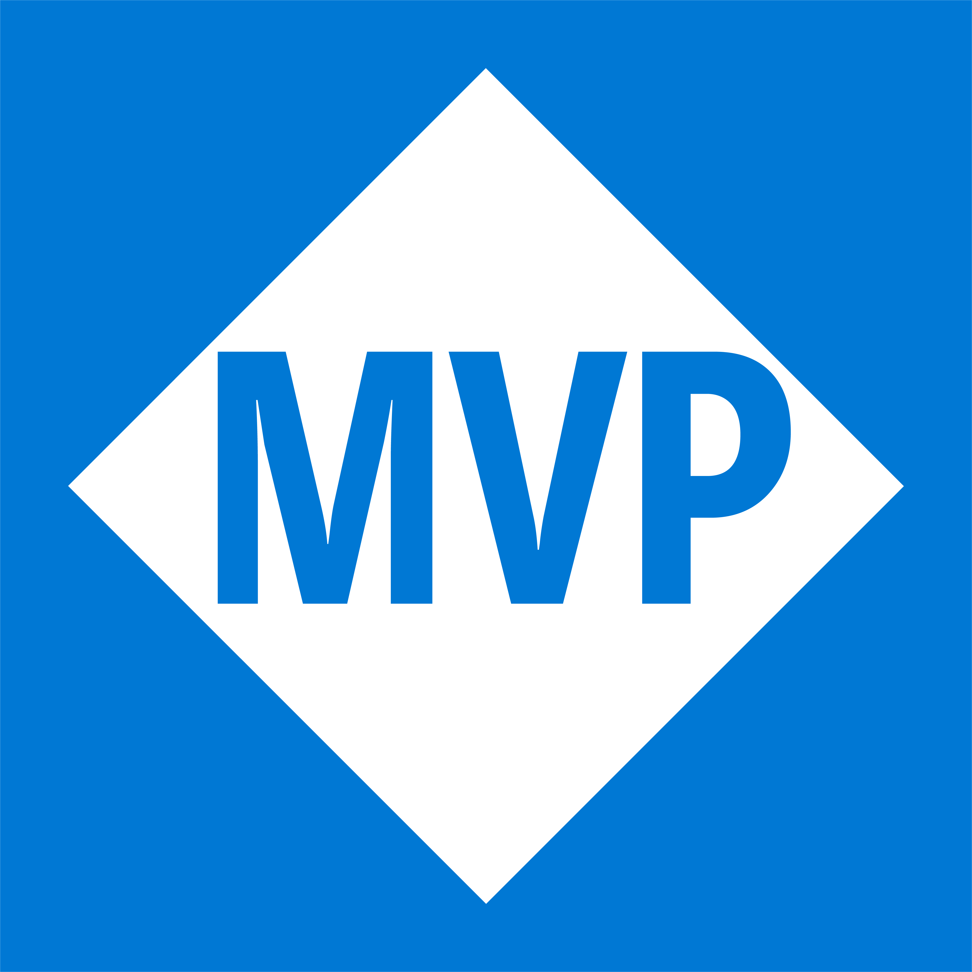


Emanuel Palm
@PalmEmanuel
🧙☕🍰🧗🥏
💙 Everything-as-Code
📦 Makes modules & tools
📃 Fan of Open Source
☁️ Blogs at pipe.how

Slide 6



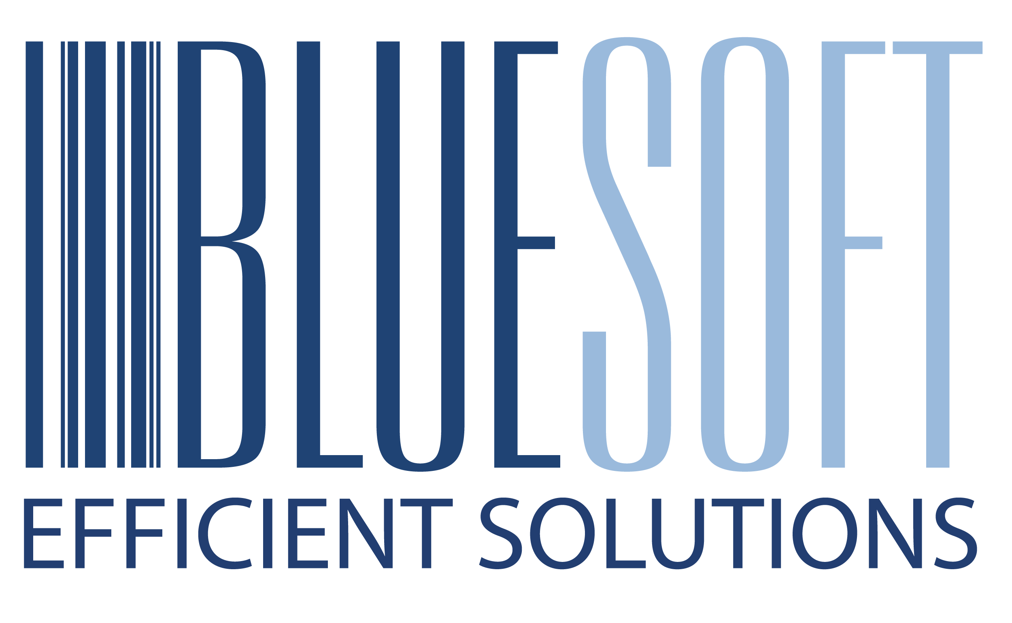

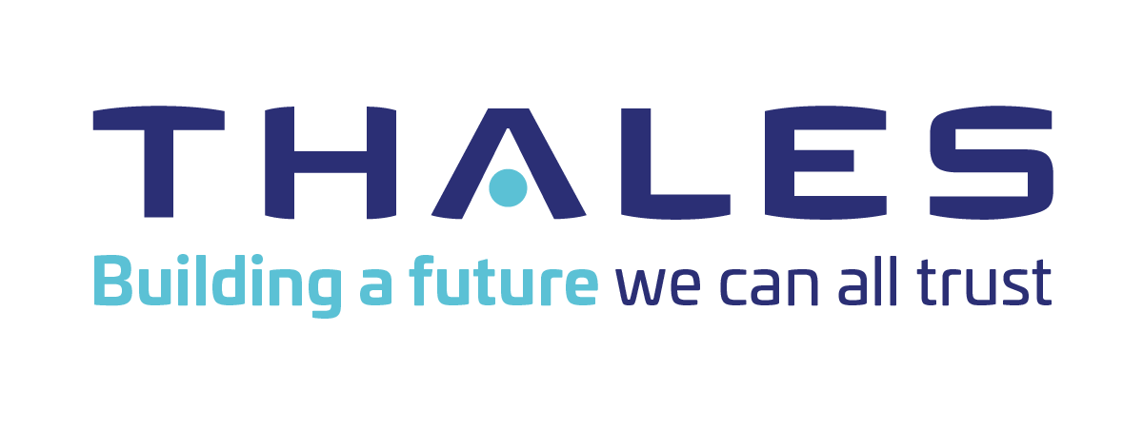

February 15th 2024
azureday.pl

Slide 7
Session Overview
Workload Identities
Security Pitfalls
Summary
Questions
Notes:
Workload Identity Types
Security pitfalls
Summary
Questions

Slide 8
Identity Types
Workload
“A collection of application resources, data, and supporting infrastructure that function together towards a defined business goal.”
- Microsoft Azure Well-Architected Framework

Slide 9


Identity
Workload
Service Accounts
“In Microsoft Entra, workload identities are applications, service principals and managed identities.”
“There are three types of service accounts native to Microsoft Entra ID: Managed identities, service principals, and user-based service accounts.”
- Microsoft Entra Workload ID documentation
- Microsoft Entra documentation
Notes:
Traditionally, they would be called service accounts.

Slide 10



Identity
Workload
Types
App Registration
Enterprise Application
Application
Service Principal

Slide 11

Entra Tenant
Application
Service Principal

Slide 12
Entra Tenant
Application
Service Principal

Slide 13

Identity
Workload
Types
User-Assigned Managed Identity
System-Assigned Managed Identity
Application
Service Principal

Slide 14
Application
Service Principal
User-Assigned Managed Identity
System-Assigned Managed Identity

Slide 15


Federated Credential
🪪
Secret📝
Certificate🔑
Registered in a single tenant Needs Service Principal(s) for operations
Application
✅
✅
✅
✅
✅
❌
Service Principal
Created for an application in a tenant *
User-Assigned Managed Identity
Connected to one or multiple Azure services Has its own resource in Azure
❌
✅
System-Assigned Managed Identity
❌
❌
Fully managed by an Azure service ♻️

Slide 16
Security Pitfalls
A non-comprehensive list in no particular order. Pitfalls can be bad. In combination, disastrous.

Slide 17
Principle of Least Privilege 🔓
1
Not following the
for the Workload Identities

Slide 18





Owner
Contributor
Reader
"roleName": “Owner", "permissions": [
{
"actions": [ "*“ ],
"dataActions": [],
"notActions": [],
"notDataActions": []
}
]
"roleName": “Contributor", "permissions": [
{
"actions": [ "*“ ],
"dataActions": [],
"notActions": [
…
],
"notDataActions": []
}
]
"roleName": “Reader", "permissions": [
{
"actions": [ “*/read“ ],
"dataActions": [],
"notActions": [],
"notDataActions": []
}
]
🤔

Slide 19
2
Using Old Versions and Tools 🛠️
Get right, stay right
Notes:
Using old tooling, like AzureRm instead of Az for PowerShell. Sometimes the difference is not obvious, especially when the functionality is the same

Slide 20



❌
AzureRM
Az

Slide 21
3
Not considering
The Entire Toolchain 🚀
Notes:
Securing the entire supply chain and pipeline (doesn’t matter if the identity can only be used from a pipeline if that pipeline isn’t locked down too, and no one can override branch policies etc)
Going a little bit outside the scope of Workload Identities only, you should really consider implementing PIM for sensitive operations in Azure DevOps as well. Activations sometimes require a logout and login and a coffee break’s worth of waiting, but not having that permanent access is great.

Slide 22




Privileged Identity Management
Azure
Azure DevOps
Service Principal
🧑‍💻
Resources
Azure Pipeline
Repository
Platform Engineer
👨‍💻
Privileged Identity Management
👩‍💻
Entra Administrator
Developer

Slide 23
4
Using Client Secrets 📝
They’re bad. Stop.

Slide 24
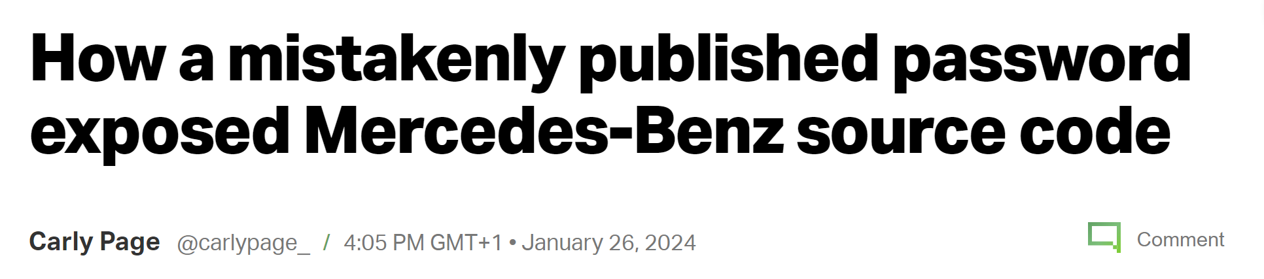
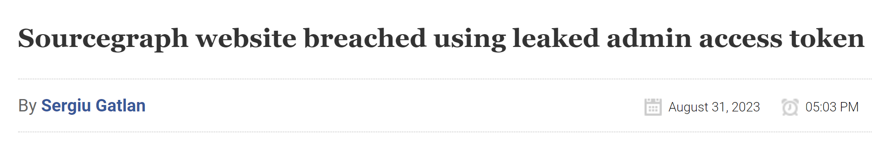
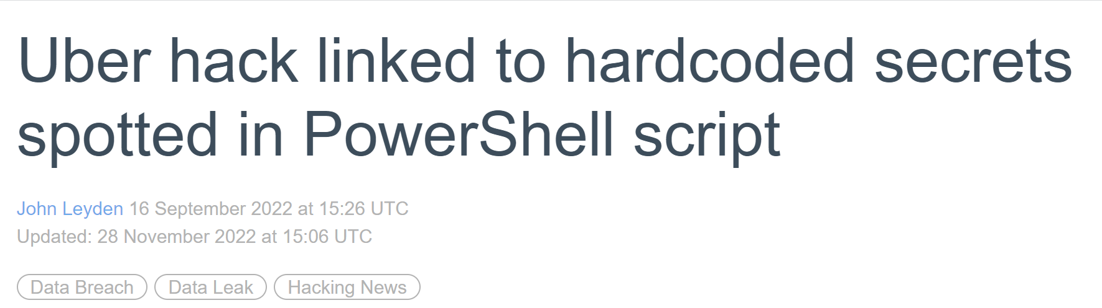
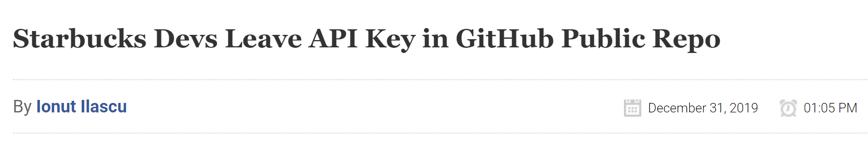
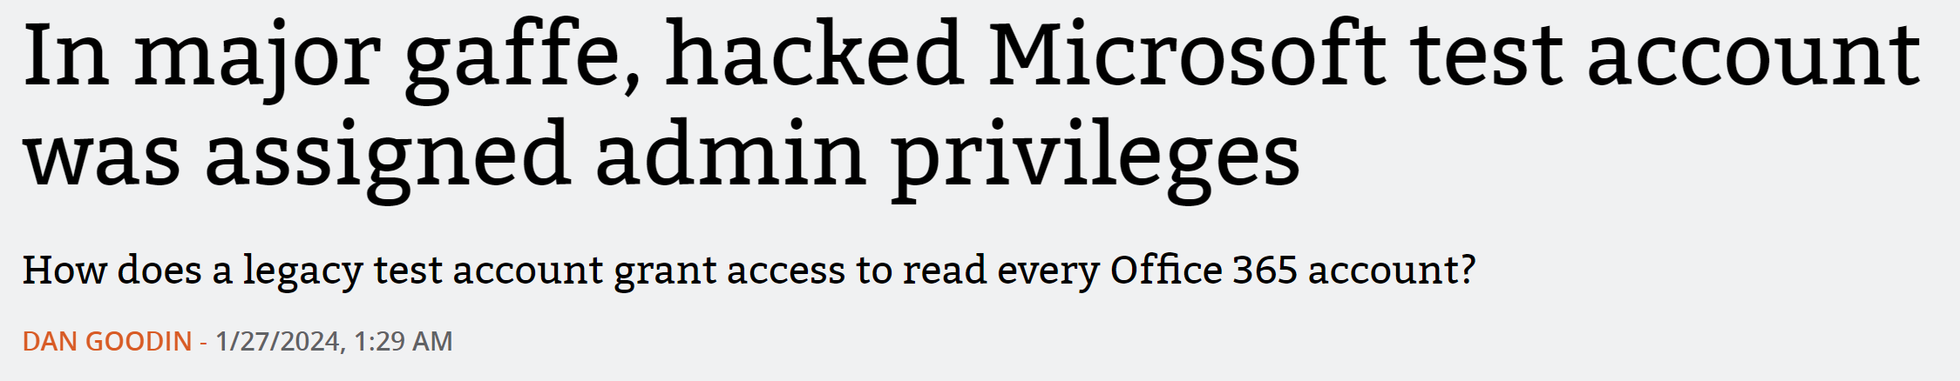

Slide 25
5
Missing Credential Management 🔐
Passwords, Tokens, Encryption Keys
Notes:
But… If we really do need passwords and secrets, we need to store them properly.

Slide 26
📖
🔐
🔁
Create a secure process for issuing!
Rotate secrets and keys often!
Secure the secrets, keys and storage!
Notes:
Don’t email secrets if they’re supposed to be secret. Adapt the process to different use cases.

Slide 27
6
Setting too long
Token Lifetimes ⌛
Notes:
Too long access token lifetime policies for applications (use proper refresh flows instead)
More and more things are implementing features like Continuous Access Evaluation so it’s better, but there are still bad ways to make things “easier” for ourselves.

Slide 28
7
Not Ensuring Traceability 🔍
for the entire process
Notes:
Not ensuring traceability (if I have access to of credentials as the app, it shouldn’t be possible for me to use it without my name showing (malicious insider scenario for example)).

Slide 29

Malicious Actor
🥷
2
Azure
Azure DevOps
1
🔍
Service Principal
👩‍💻
Resources
🔍
🔍
Azure Pipeline
Repository
🔍
Developer
Azure Key Vault

Slide 30
8
Not Monitoring and Acting 🕵️
Sign-ins, added credentials, anomalies
Notes:
Monitoring sign-ins and logs for anomalies. Audit and alerting for reading sensitive secrets if it’s not done by an identity that should.

Slide 31

Azure
Azure DevOps
Service Principal
👩‍💻
Resources
Azure Pipeline
Repository
Developer
Azure Key Vault

Slide 32
9
Not using Workload ID Premium 💎
Previously Workload Identity Premium for confusion

Slide 33
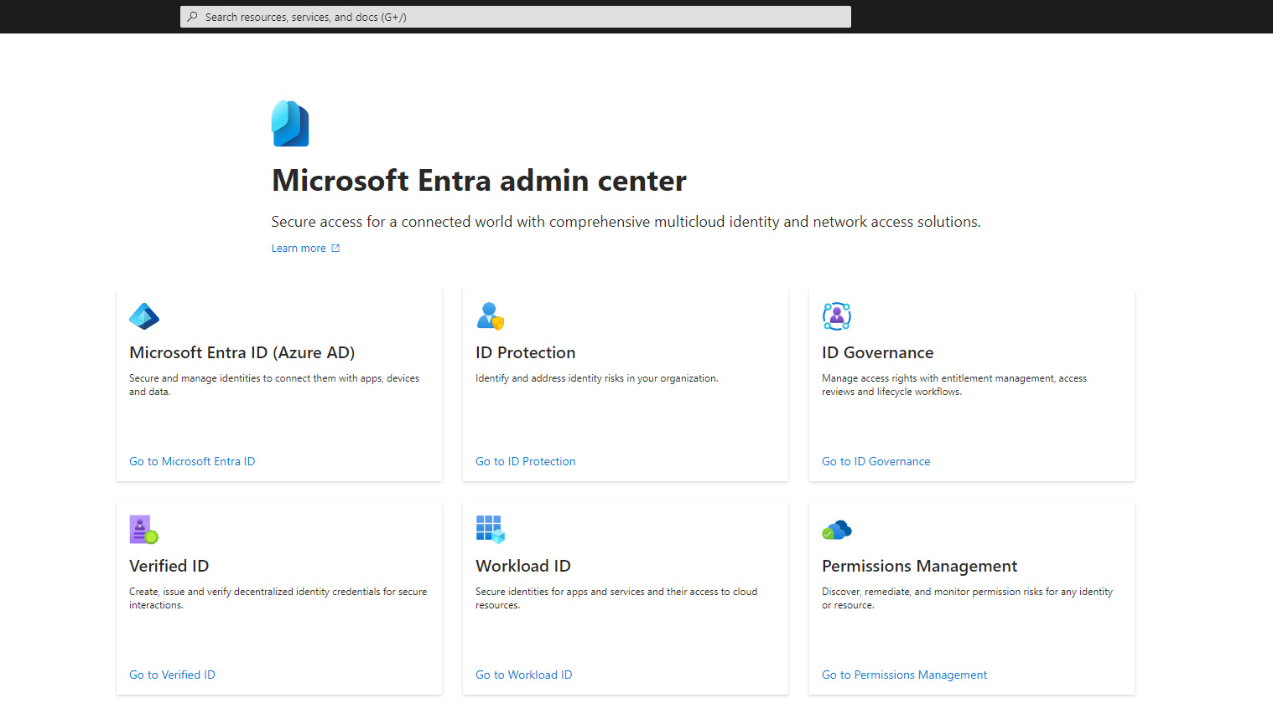
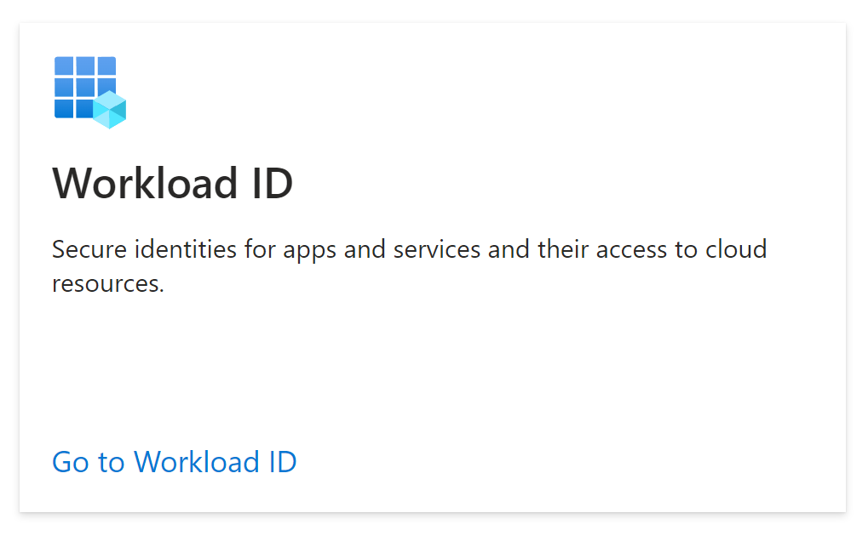

Slide 35



Workload ID Premium Features 💎
Location-based
Conditional
Access
Risk-based
Notes:
If the identity should only be used from on-prem, limit it, if it should only be used from west europe Microsoft-hosted agents in Azure DevOps, limit it etc
There is a scenario with IP based conditional access which is tricky for applications when using Federated Credentials, for the first token handshake.

Slide 36



Workload ID Premium Features 💎
Suspicious sign-ins
Leaked Credentials
Conditional
Access
Identity
Protection
🪄
Entra Threat Intelligence

Slide 37

Workload ID Premium Features 💎
Conditional
Access
Identity
Protection
Access
Reviews

Slide 38

Workload ID Premium Features 💎
Conditional
Access
Identity
Protection
Access
Reviews
App Health Recommendations

Slide 39
10
Creating and using
User-Assigned Managed Identities 👤
without a strategy
Notes:
User-Assigned Managed Identities (unintentional assigning & Azure Policy works for them!)
Azures best practices for Azure Policy for UAMIs are a bit off

Slide 40

Contributor
IT Operator
🧑‍💻
"roleName": “Contributor", "permissions": [
{
"actions": [ "*“ ],
"dataActions": [],
"notActions": [
…
],
"notDataActions": []
}
]
User-Assigned Managed Identity
Service Principal
GitHub Action
Secret 📝
🪪
Federated Credential

Slide 41
11
Sharing Workload Identities 👥
between multiple services
Notes:
There are few cases where it makes sense. In enormous organizations, Microsoft recommends it for certain policy scenarios, but those are edge cases.

Slide 42




Owner
Key Vault Crypto Officer
"roleName": “Owner", "permissions": [
{
"actions": [ "*“ ],
"dataActions": [],
"notActions": [],
"notDataActions": []
}
]
"roleName": “Key Vault Crypto Officer", "permissions": [
{
"actions": [ … ],
"dataActions": [
"Microsoft.KeyVault/vaults/keys/*",
…
],
"notActions": [],
"notDataActions": []
}
]
App Service
Kubernetes Cluster
AcrPull
"roleName": “AcrPull", "permissions": [
{
"actions": [
“Microsoft.ContainerRegistry/registries/pull/read”
],
"dataActions": [],
"notActions": [
…
],
"notDataActions": []
}
]
User-Assigned Managed Identity
Virtual Machine

Slide 43
12
Missing Lifecycle Process ♻️
On- & offboarding for your Workloads
Notes:
No clear life cycle process for all types (if we have clear on&offboarding for users, why would we allow these potentially less secure identities to be without?)

Slide 44
13
Missing Accountability and Ownership 🏴‍☠️
Who’s in charge?

Slide 45
14
Missing Access Reviews 🚫
Why can this app do that?
Notes:
Whether it’s through Entra Workload ID Premium or custom, it’s important to know why your identities have the permissions they do, and to follow up on them to ensure that they still need the access.

Slide 46
Principle of Least Privilege 🔒
15
Not following the
for access to the Workload Identities
Notes:
Not restricting who has access to use the workload identities

Slide 47
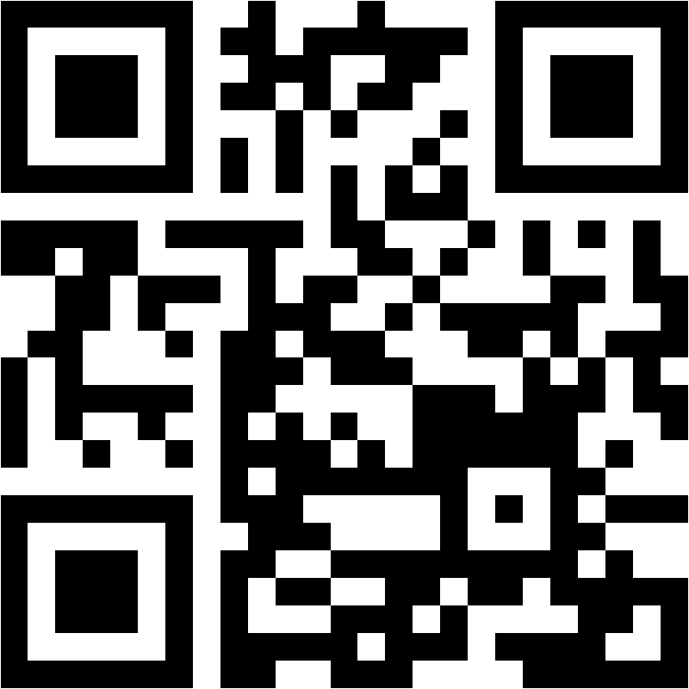

Please rate my session in the Mobile App!
February 15th 2024
Konfx
azureday.pl

Slide 48





Takeaways
🔓🛠️🚀📝🔐⌛🔍🕵️💎👤👥♻️🏴‍☠️🚫🔒
🤔❎2️⃣
Use System-Assigned Managed Identities
Think twice!
Utilize the platform!
🔓🛠️🚀📝🔐⌛🔍🕵️💎👤👥♻️🏴‍☠️🚫🔒
@PalmEmanuel
pipe.how

Slide 49
Questions?
Thank you!
🔓🛠️🚀📝🔐⌛🔍🕵️💎👤👥♻️🏴‍☠️🚫🔒
🔓🛠️🚀📝🔐⌛🔍🕵️💎👤👥♻️🏴‍☠️🚫🔒
@PalmEmanuel
pipe.how

